Slide 1

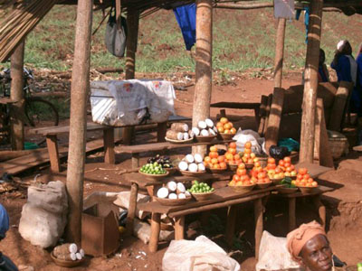
Informal Sector
Concepts and characteristics of informal sector employment.
Reasons for high informal sector employment in South Africa
Case studies from three informal sector contexts
Challenges facing South Africa’s informal sector
Learning objectives

Slide 2
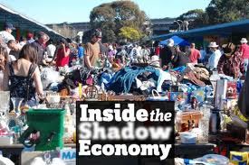

Slide 3
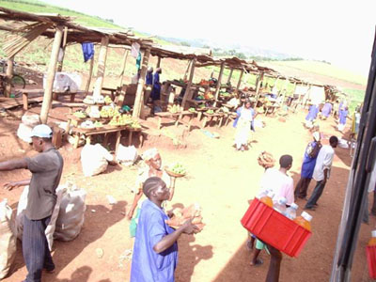
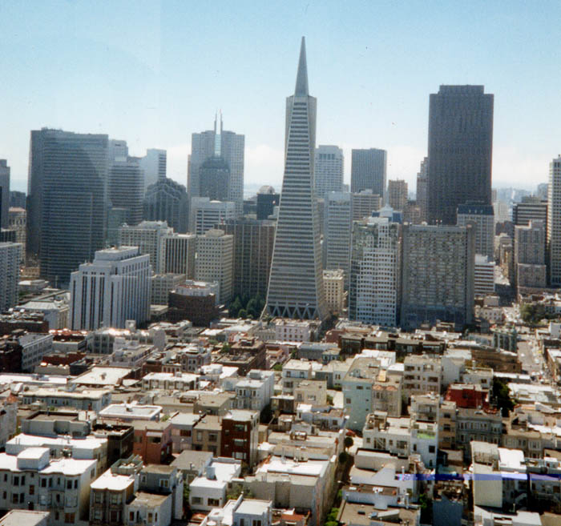
What are the formal and informal sectors?
Most LEDC cities have grown rapidly and the number of people is often far greater than the jobs that are available.
People therefore have to find work for themselves. This is called the informal sector of employment.
The formal sector is controlled by the government and large companies.

Slide 4
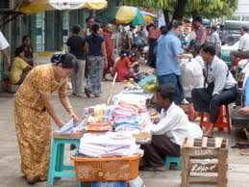
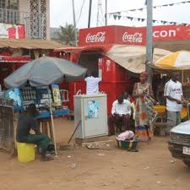
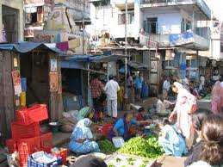
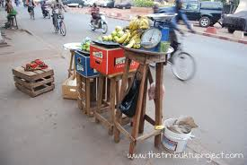
Street traders
Petty trade
Casual employment
Self-appointed tourist guides
Spaza shops

Slide 5
Formal and informal employment
Source: Boardworks software

Slide 6
Formal and informal employment
Source: Boardworks software

Slide 7
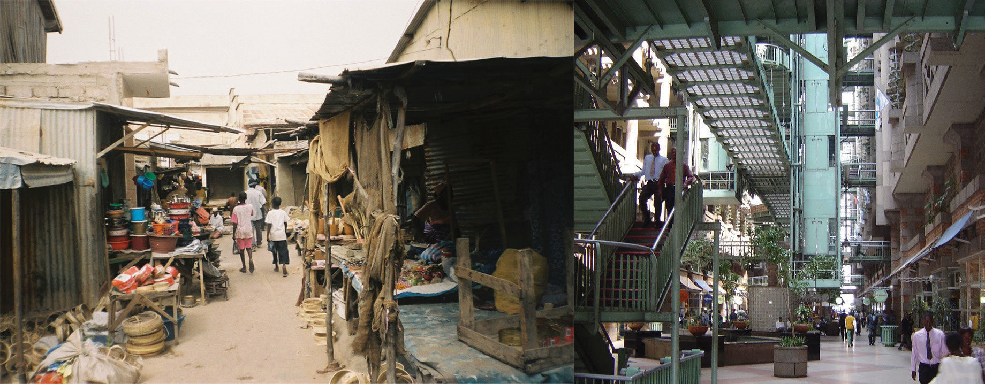

Industry in LEDCs
The informal sector of employment is created by people finding work for themselves. This is usually due to the rapid growth of LEDC cities. Some examples of jobs are scrap collectors, street entertainers and shoe shiners.
The formal sector of employment is controlled by the government and large companies. Some examples of jobs are factory workers, shop assistants and nurses.
Key ideas

Slide 8
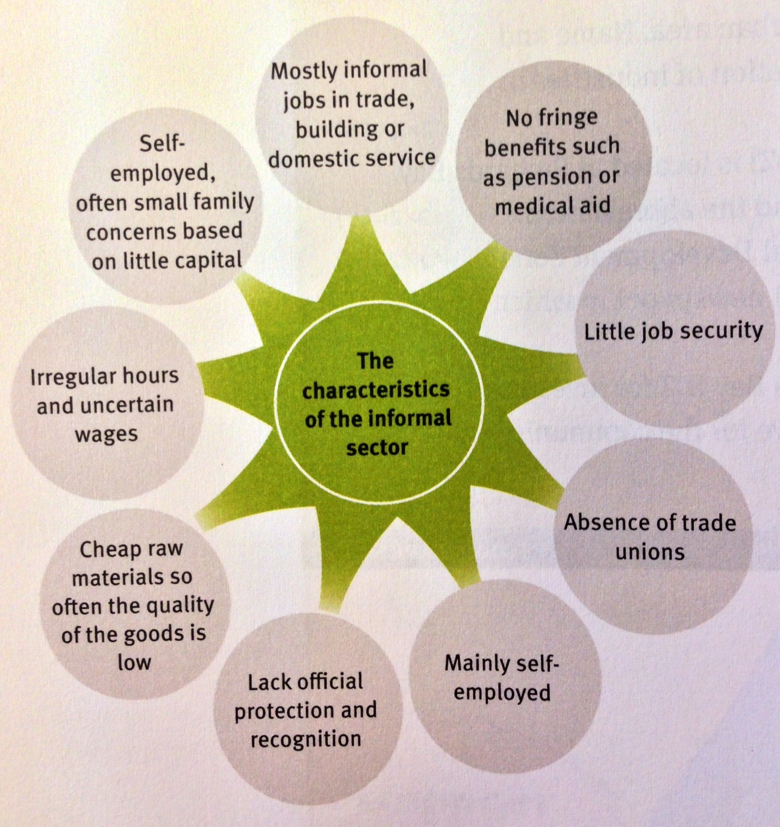
Characteristics of informal Sector
Source: Via Afrika Geography

Slide 9
Informal Sector
Concepts and characteristics of informal sector employment.
Reasons for high informal sector employment in South Africa
Case studies from three informal sector contexts
Challenges facing South Africa’s informal sector
Learning objectives

Slide 10
Statistics on high Informal Employment
It is estimated that about 3 million out of a labour force of about 13 million are in the informal sector and is growing at 8% per year.
It accounts for between 5 – 10 percent of GDP.
The official present unemployment rate is 25%.
South Africa has the 69th biggest informal sector in the world just after Greece(68th) and before Poland(70th)

Slide 11
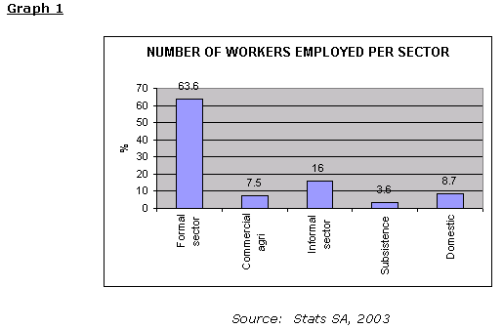
Graphs
It is evident that the informal sector makes up
a large part of the economy. Close to 1 in 5 workers were
involved in the informal sector in 2003 and by
now it is definitely 1 in every 5.

Slide 12
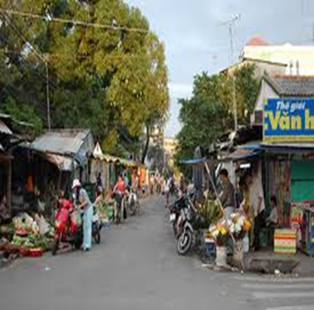
Why are these stats so high?
Under apartheid, black people were denied entry to much of the economy except as unskilled or semi-skilled labourers. With many of these people unable to get education they enter into the informal sector.
As unemployment increases, so does the informal sector.
Many informal jobs are carried out by non-South Africans (Zimbabweans) as they are often denied formal employment.

Slide 13
Informal Sector
Concepts and characteristics of informal sector employment.
Reasons for high informal sector employment in South Africa
Case studies from three informal sector contexts
Challenges facing South Africa’s informal sector
Learning objectives

Slide 14
Informal Trading in Mangaung
A survey was conducted in the Mangaung municipality in the Free State.
It found that:
30% of traders were women
Age range was 18 – 64
31% had no secondary education
21% were also employed in the formal sector
There was a wide range of occupations
The traders earn an average of R5 300 per month but this varies considerably.
The highest earner was a shebeen operator who made R90 000 a month.

Slide 15
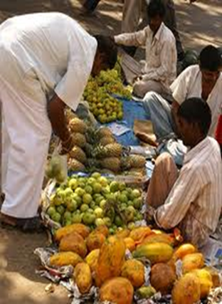
Mangaung Informal Traders
Agriculture is aided by informal traders, as hawkers buy nearly half of the potatoes traded on markets and a quarter of all market produce in Mangaung. This share is growing by 2%.
40% of Coca Cola sales in South Africa are generated by informal traders.

Slide 16
Division of Informal jobs

Slide 17
Informal Sector
Concepts and characteristics of informal sector employment.
Reasons for high informal sector employment in South Africa
Case studies from three informal sector contexts
Challenges facing South Africa’s informal sector
Learning objectives

Slide 18
Challenges facing the Informal Sector
People earn less income, which is irregular and variable.
Businesses lack the potential for growth.
Limited access to raw materials and funding.
Usually outdoors no matter the conditions.
People have little time or incentive to improve their education or training.
Many have diseases, and as work gets tougher they start to struggle.
Many foods and goods are sold off the pavement which is extremely unhygienic and unhealthy.
Many of the informal workers are subject to xenophobia because they are foreign.

Slide 19
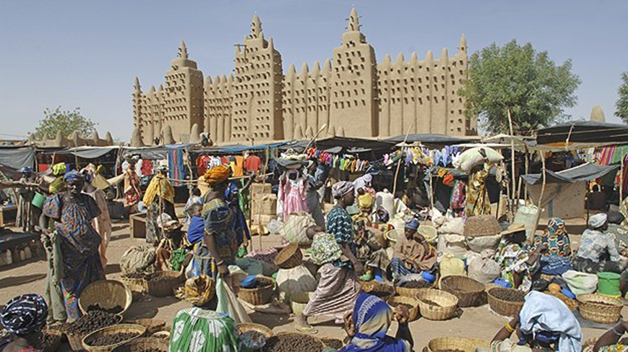
Challenges facing the Informal Sector
Many people in the informal sector have no other choice, they have no money or can’t find a job anywhere for numerous reasons and so have to work in the informal sector.
Many of the foreigners that come to South Africa for brighter futures end up in the informal sector because nobody will give them a job.
The sector is continuously growing and needs to be halted.

Slide 20
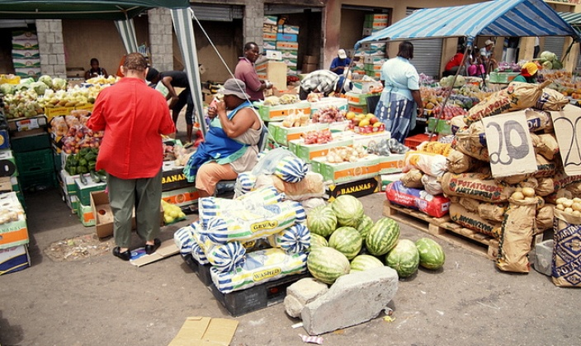
Time to think
How can we make an influence in helping people in
the informal sector receive proper education and training
or give them the opportunity to fairly apply for a job in
the formal sector?

Slide 21


