Slide 1
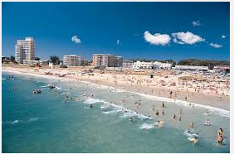
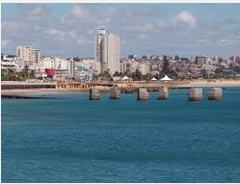
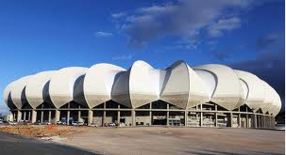
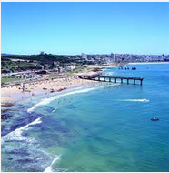
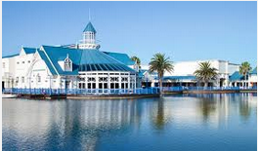
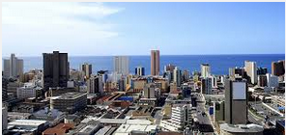
The Port Elizabeth Uitenhage (Nelson Mandela) Region
http://www.youtube.com/watch?v=GtKlQTbxcHc

Slide 2
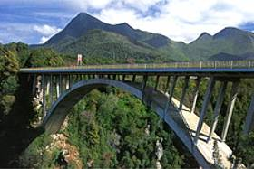
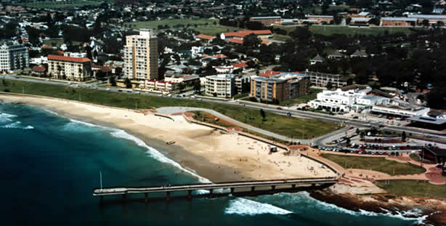
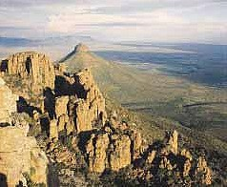
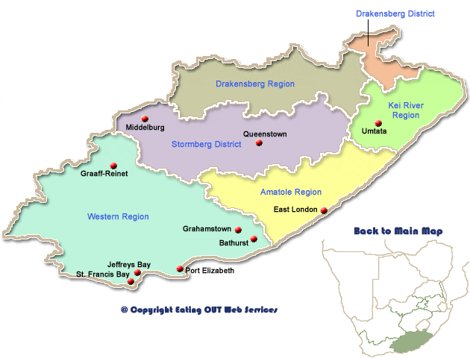
Eastern Cape

Slide 3
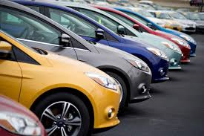
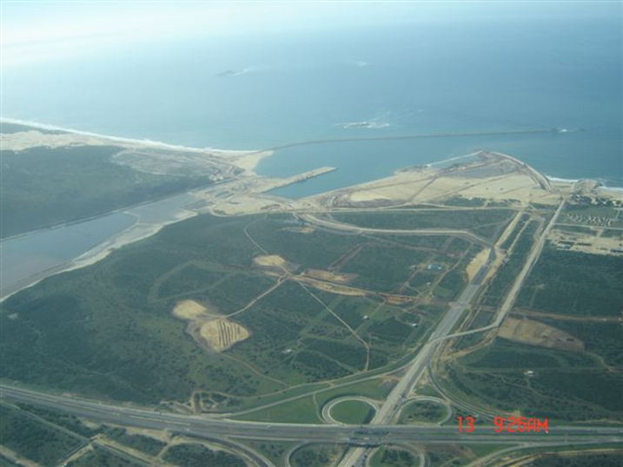
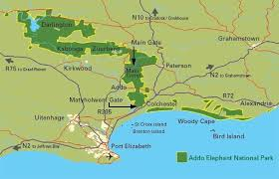
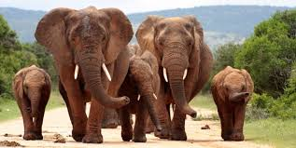
Eastern Cape Advantages
Central position to Durban and Cape Town
Much labour available
Foreign investment in motor industry (VW stared in Uitenhage in 1926 - GM pulled out in 1980’s, now improved)
Coega is meant to stimulate economy
Wild coast, Addo Elephant Park – eco-tourism

Slide 4
Eastern Cape Disadvantages
Underdeveloped because of previous homelands, Ciskei and Transkei – poor services, infrastructure (few access roads, no piped water, few schools)
Poor environment – many subsistence farmers, overgrazed, trees cut for firewood and footpaths cause erosion
Overcrowding, overgrazing and soil erosion
Limited job opportunities
Labour costs too high – Asia and E. Europe car manufacturing
Strikes / labour unrest

Slide 5
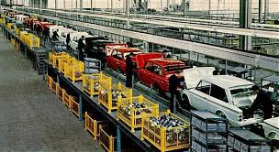
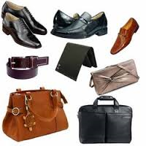
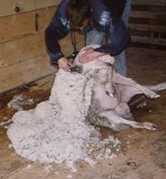
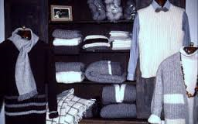
MANUFACTURING INDUSTRIES FOUND IN THIS REGION
Motor vehicles
General Motors and Ford opened assembly plants in 1926
Volkswagen began assembling cars in 1947
Since 1960 more components have been made in factories in this region – lights, wiring, engine parts, glass windscreens and windows
Tyres are made in Port Elizabeth
Leather goods
It started with making shoes, but now includes the making of car upholstery
Textiles
Wool and cotton clothing

Slide 7
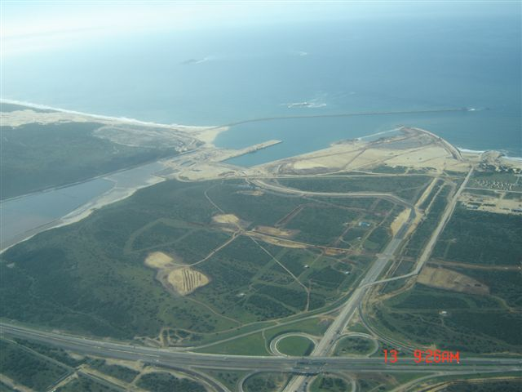
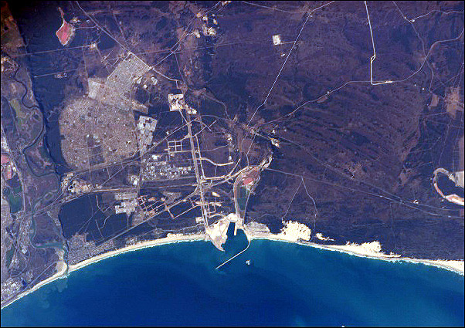
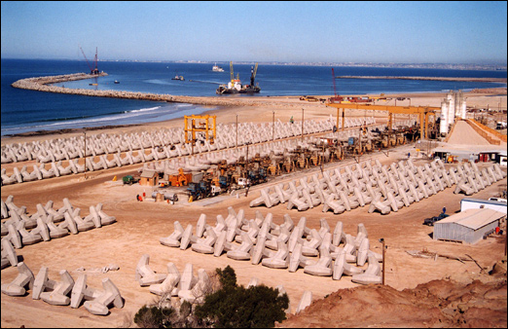
Coega Harbour
Dollos near Coega

Slide 8
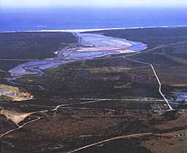
Coega Promises
Deep water port
Attract foreign companies
Plenty of space to expand
Regular water supply from Orange-Fish Tunnel
Government backed project
New jobs
New improved infrastructure
Foreign investment
New skills learnt
Increased tourism
Coega Issues
Long distance to main market of Gauteng, when Richards Bay and Maputo are available
E. Cape cannot support this venture financially. Foreign investments promised but not delivered and rand has devalued.
White Elephant?
Pollution

