Slide 1
GAUTENG / PWV
THE MOTHER OF US ALL

Slide 2
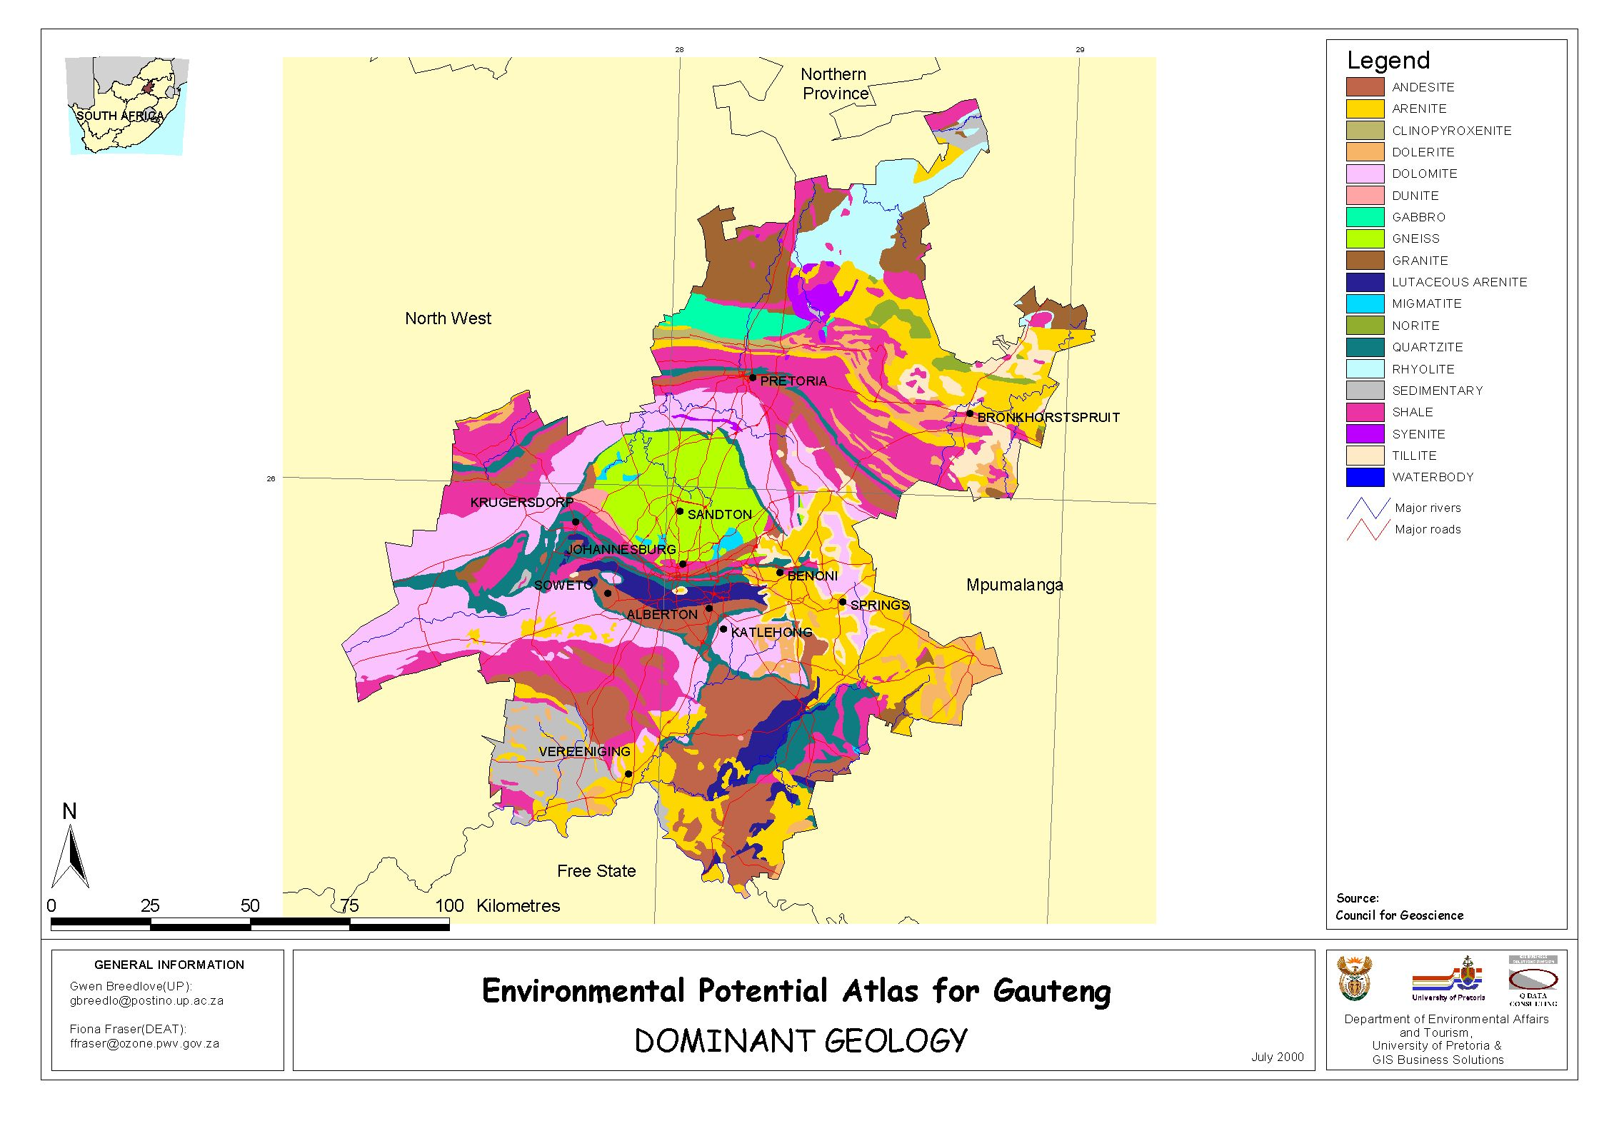

Slide 3
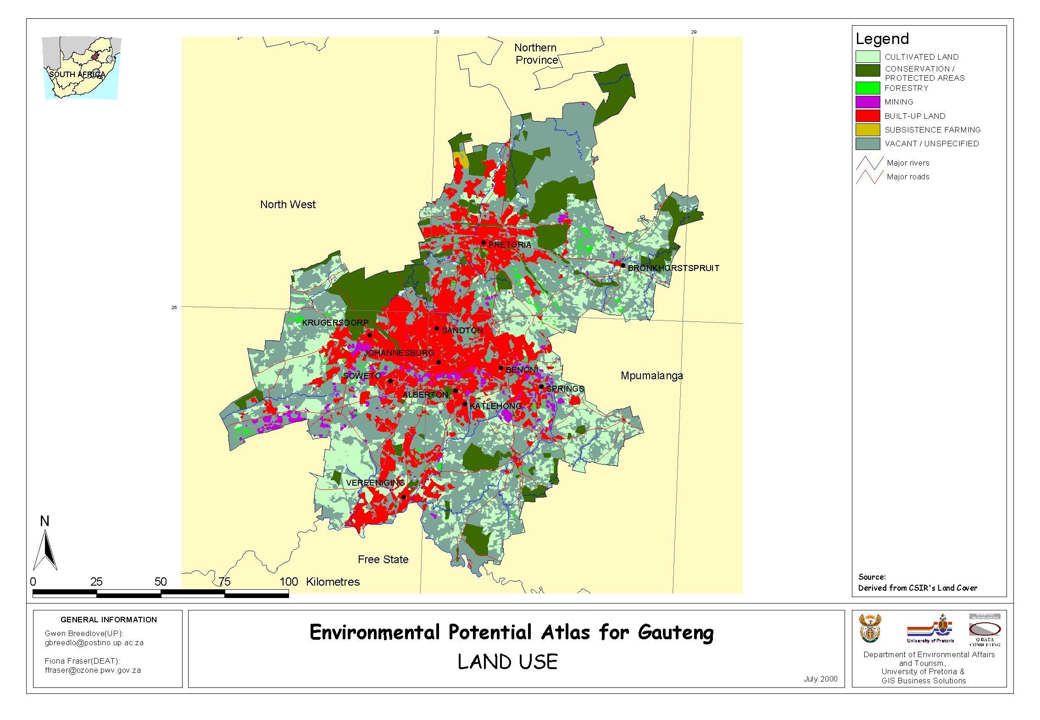

Slide 4
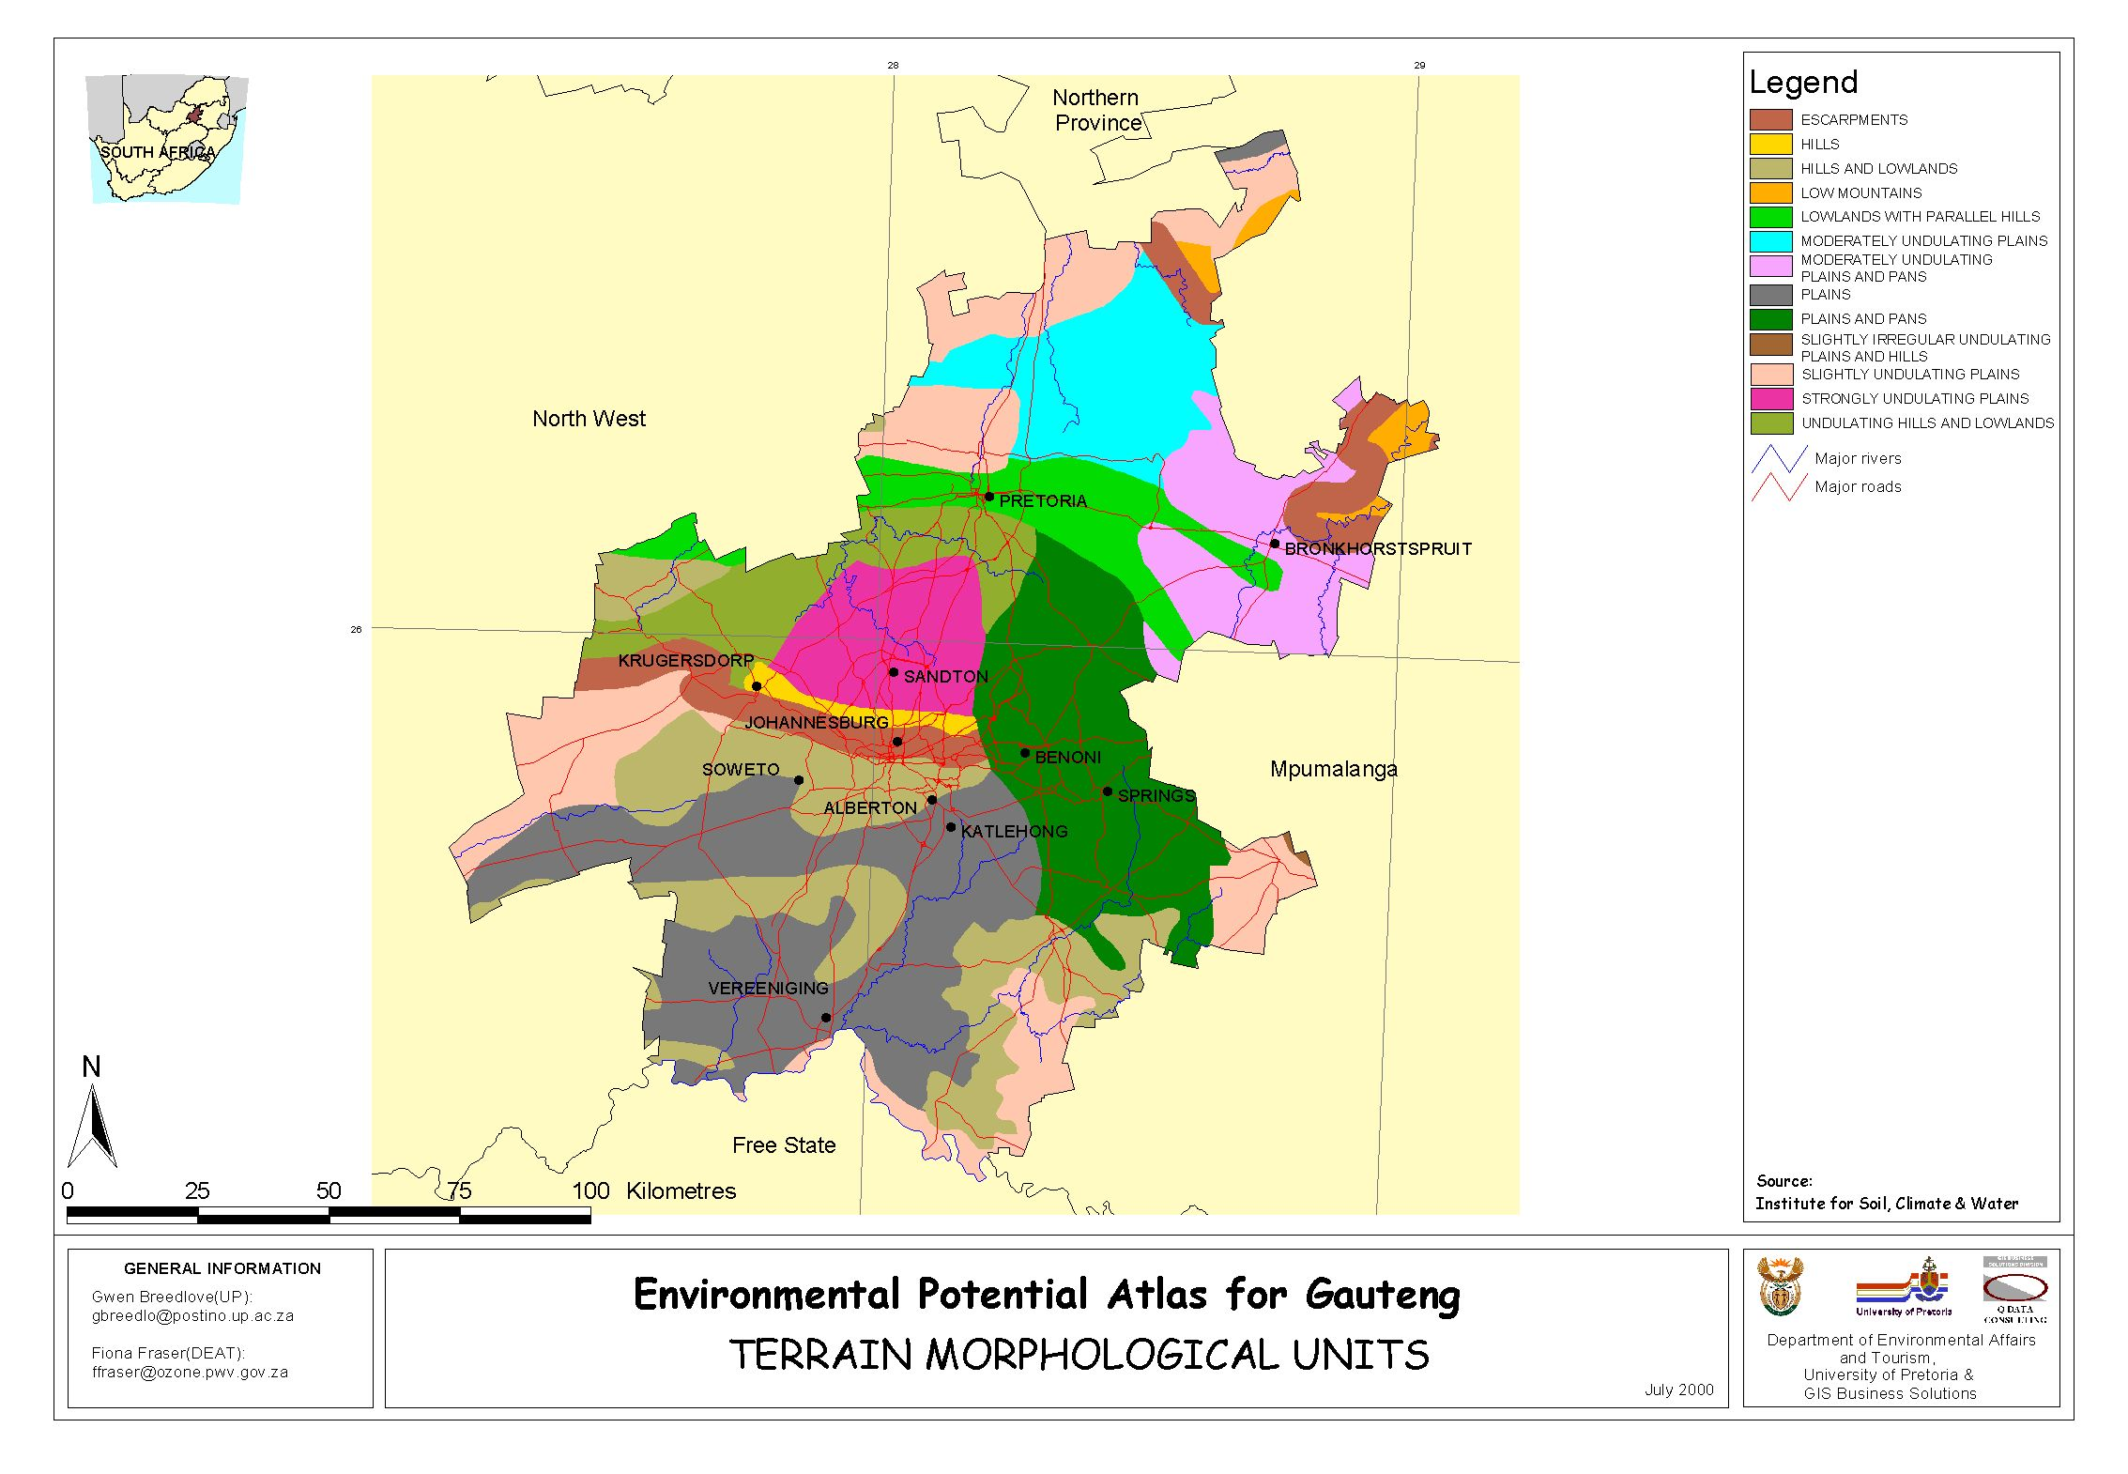

Slide 5
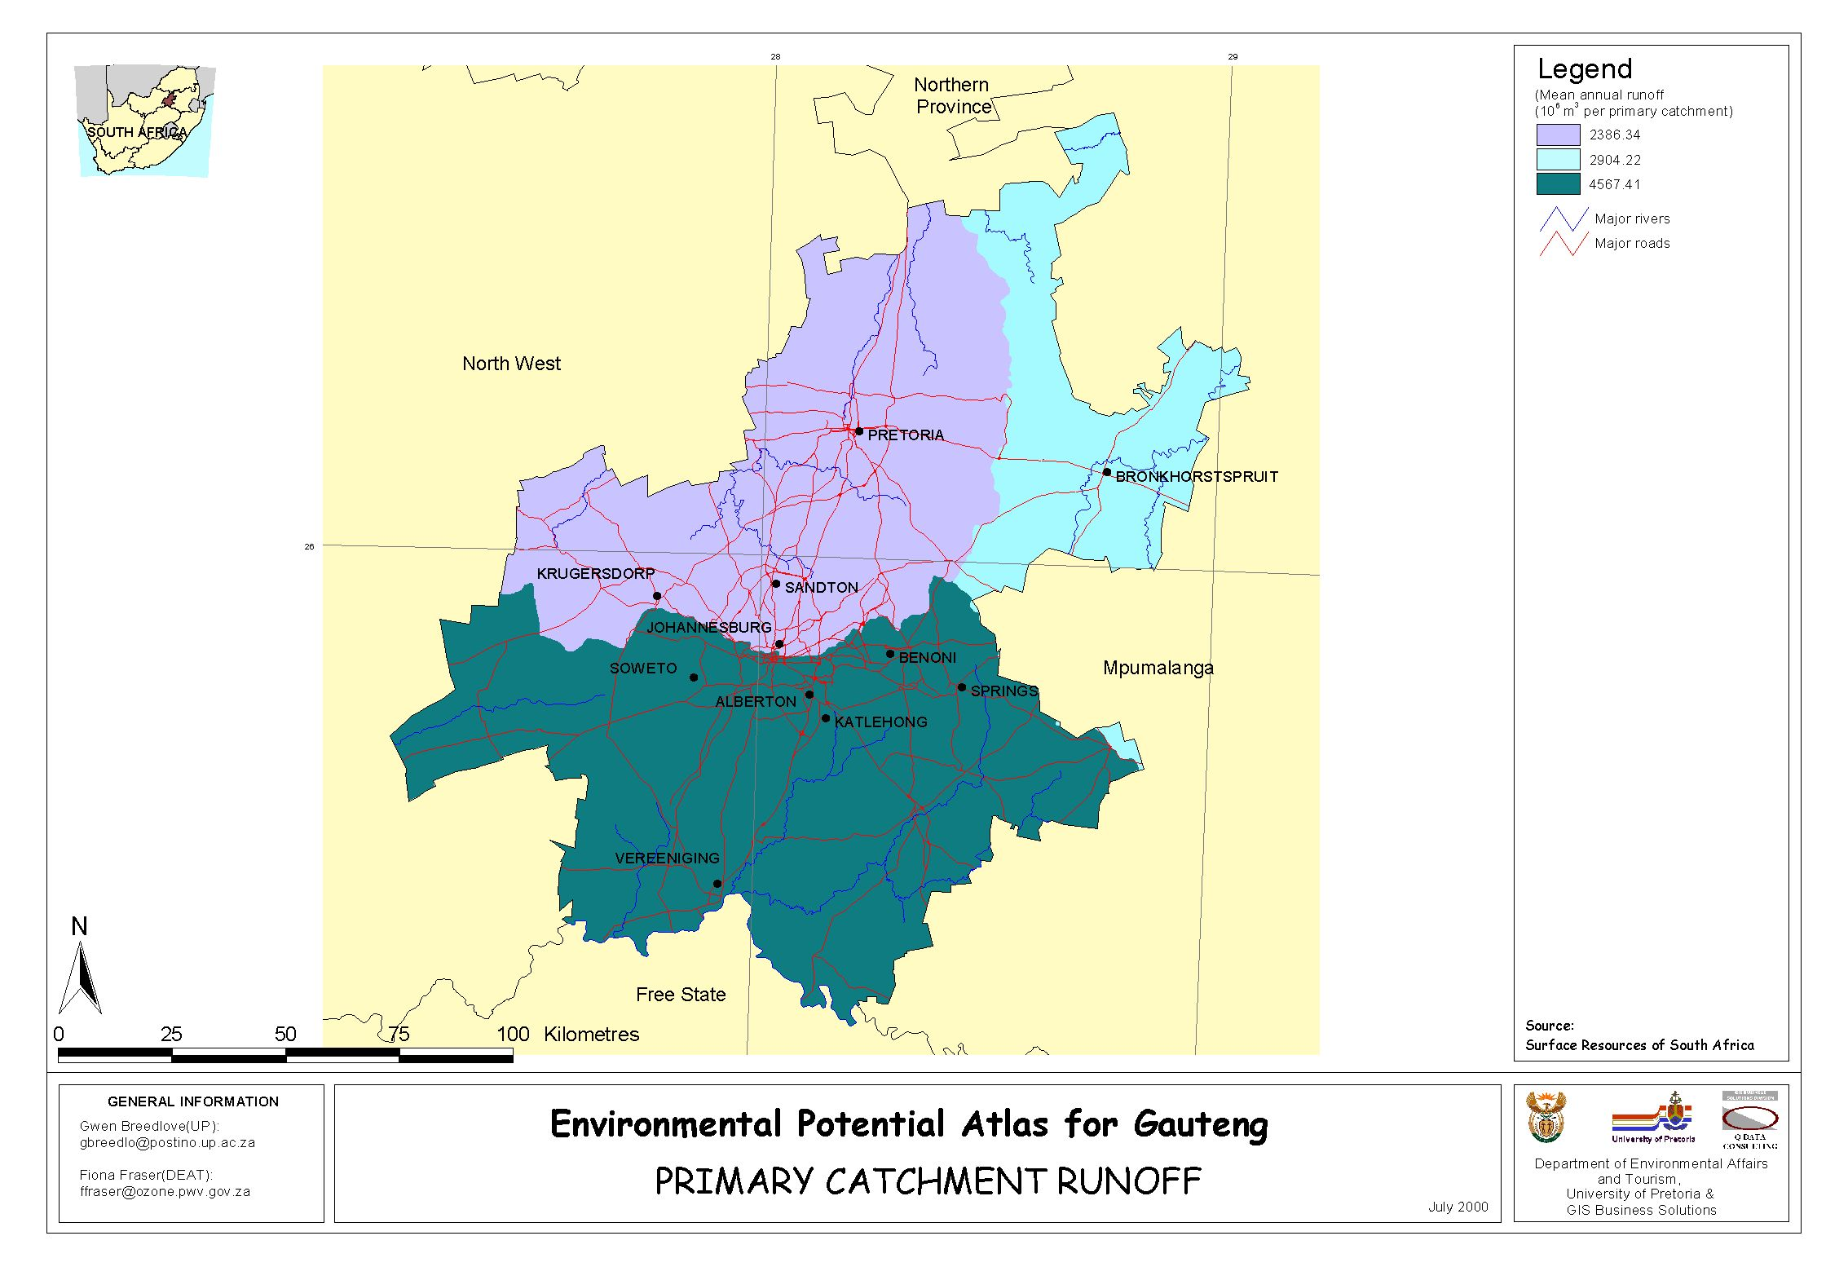

Slide 6
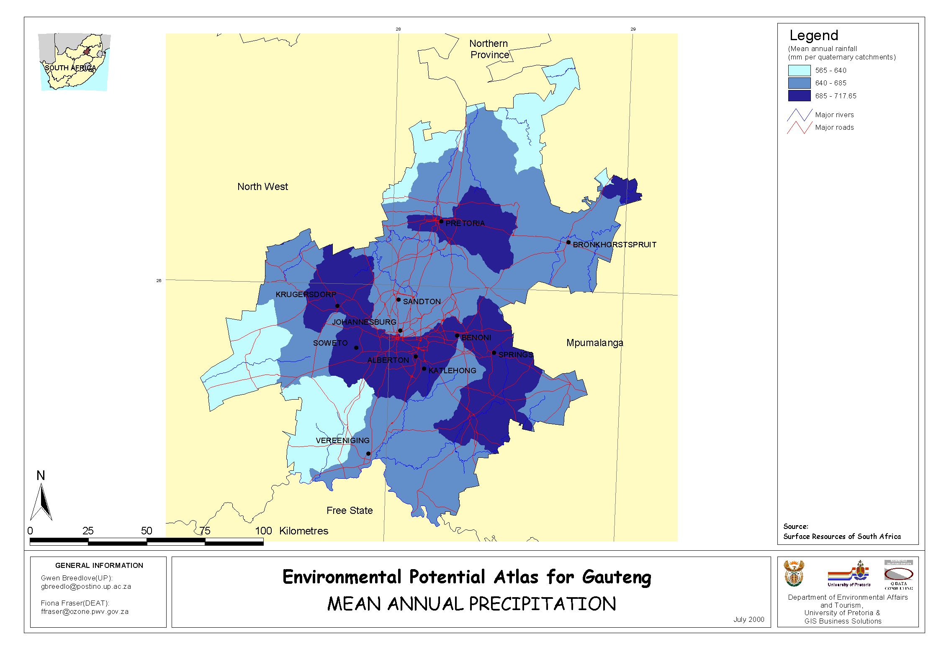

Slide 7
Gauteng Fact Box
30% of SA population
370 people/km2
97% urbanised – not necessarily civilized?
70%of SA’s labour force
22% contribution to mining sector
38% of SA’s GDP
1,4% of SA’s area The Star, January 2003

Slide 8
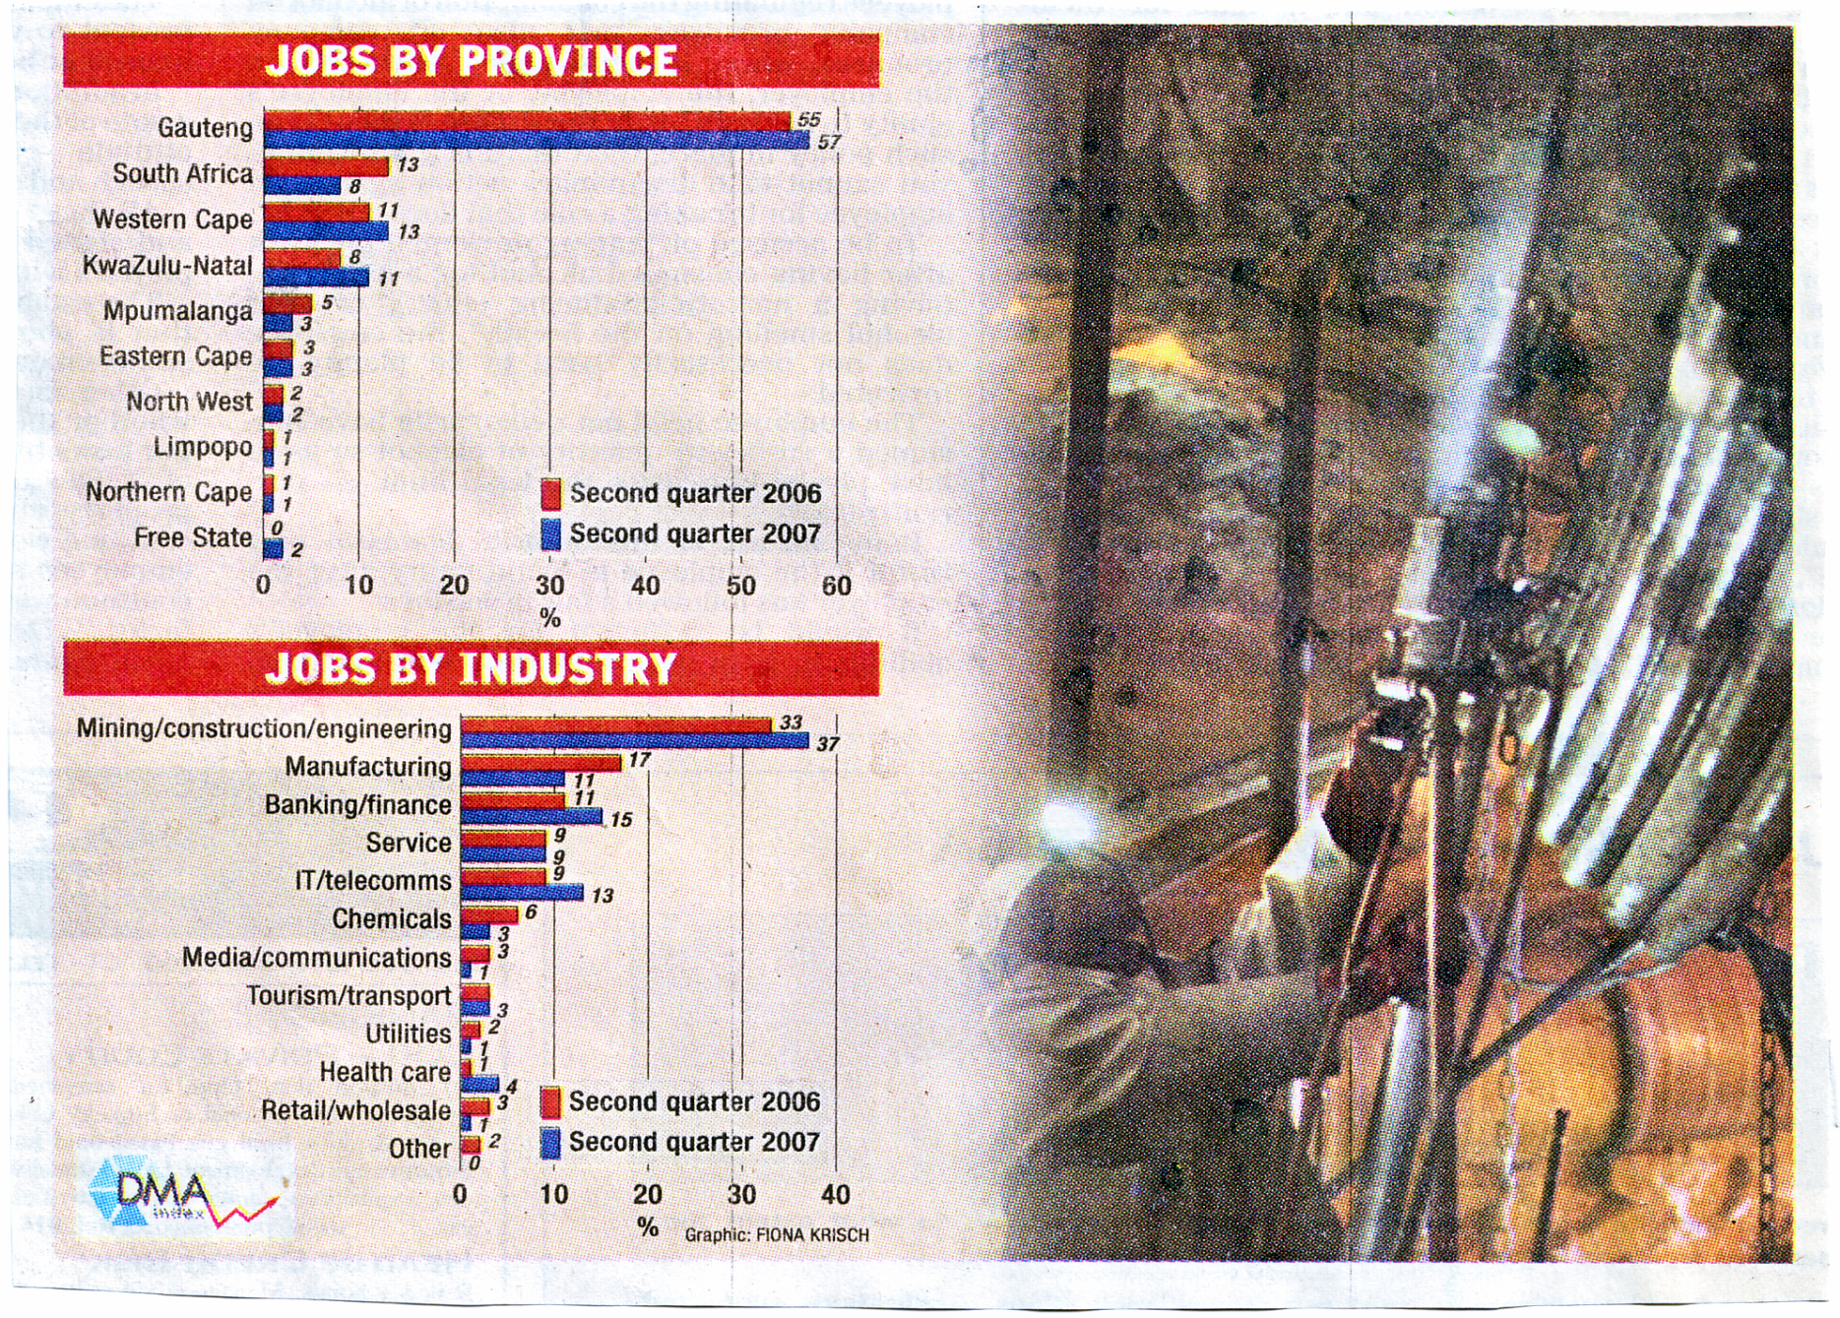

Slide 9
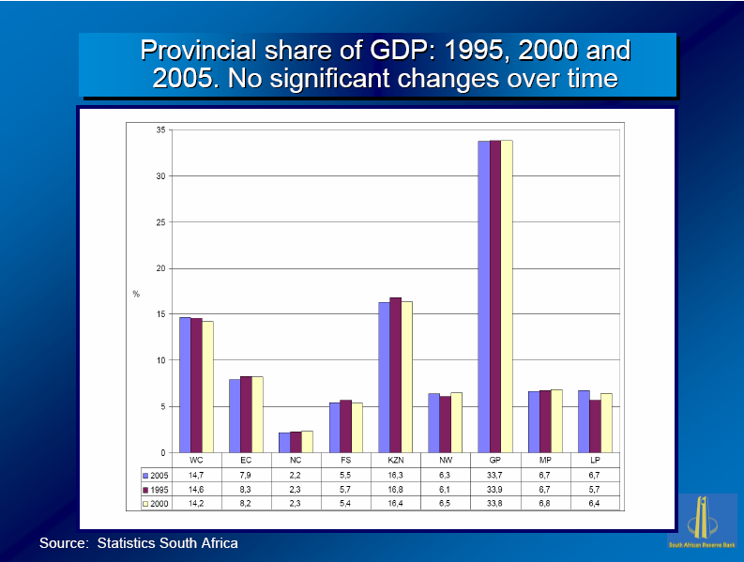

Slide 10
Factors Favouring Industry in Gauteng
Central position in SA
Flat land
Gold mining attracted skilled labour
Water – TVTS, LHWP
Electricity from Mpumalanga
Better salaries
Excellent infrastructure

Slide 11
Factors Favouring Industry in
Gauteng
Raw materials close by; platinum, gold, maize, coal and iron
Transport links well established
Large local market – rural and African migration
Many technikons/uni’s/colleges to impart skills
Close to Harbour’s – Richards Bay, Durban and Maputo

Slide 12
Major Industries
Major Industries
ESKOM
AECI
AFROX
ISCOR
SASOL
Food and beverages
Motor vehicles – market and steel
Major Services
Stock exchange
Banking
IT

Slide 13
Over Centralisation Issues
AKA Agglomeration
Congestion
Pollution – air, noise, land
Insufficient housing
Infrastructure becomes over used – power cuts
Insufficient jobs-no money, squatter camps and crime

Slide 14
Mining’s contribution to JHB
JHB 1886
Brought people – towns established
Supporting industries e.g. explosives, wood, clothing etc.
Road and rail network
Other infrastructural development – electricity, hospitals and schools, water

Slide 15
Mining and JHB today
Many gold mines exhausted and closed
Mines on edge of golden circle still successful
Secondary industries are well entrenched
Tertiary activities dominate e.g. business tourism, banking and selling

Slide 16
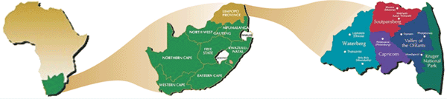
Limpopo

Slide 17
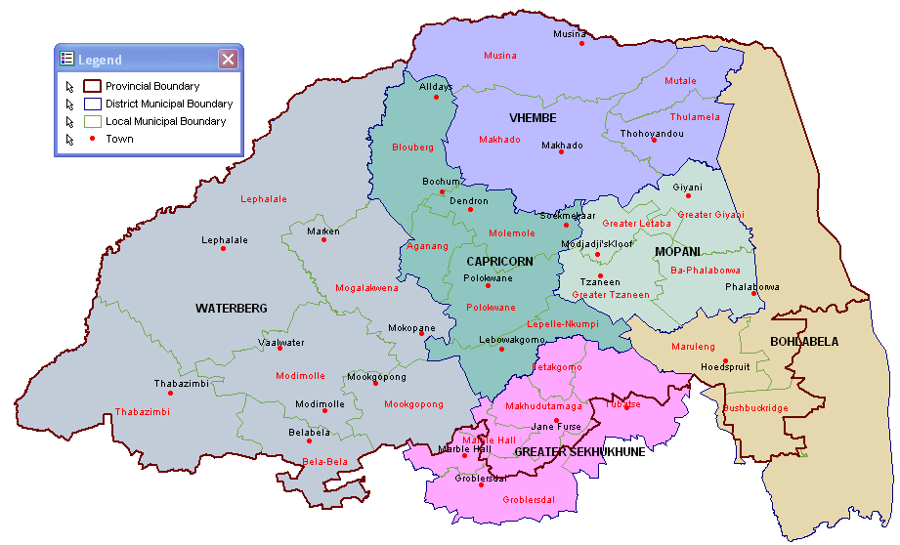
Limpopo

Slide 18
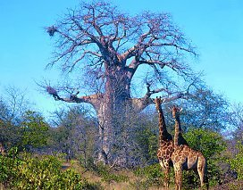
Limpopo
Kruger National Park, Waterberg, Nylsvlei (for birding) and hot springs (Warmbaths)
Previous homelands – Lebowa, Venda, Gazankulu – little infrastructure, low level of education
Farm tropical fruit near Phalaborwa, Copper mines

Slide 19
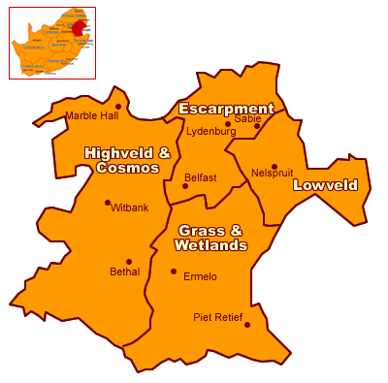
Mpumalanga

Slide 20
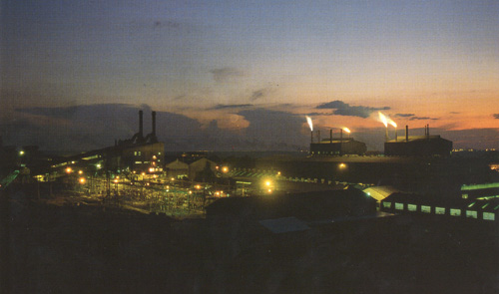
Mpumalanga
“Powerhouse” of SA – generates 90% of SA’s energy by coal fired power stations – but coal is a non-renewable resource?

